Slide 1
One Time Charge Solution – GMSA
Deepak Kumar Sharma
May 3, 2021

Slide 2
Business Requirements
Claro want One time charge fees (associated with a productid/plan) to be included in below scenarios–
Scenario 1 – One time Charge fees should be calculated at the time of completion of the addorder.
Scenario 2 – Biginvoice Report should have One time charge fees (associated with a productid/planid) for the given month.
Scenario 3 - Calculate and show associated ‘OTC charge’ for every ICCID in Monthly “OTC Report”.
OTC Report (monthly) structure should be :-
a. OTC Report (monthly) - ‘IMSI’ ‘ICCID’ ‘MSISDN’ ‘OTC’ ‘product id’ ‘Timestamp’

Slide 3
Assumptions
Assumptions – (All agreed by Claro Team)
One time charge will be applied whenever addorder have any of the ProductID from GMTR1, GMTRE, GM20D. → Agreed
Claro will inform Airlinq if there is any change in the product Ids where One time charge need to be applied. → Agreed
AQ will not do any check related to the validity of the Plan/product Id. → Agreed
One time Charge and Activation charge will be calculated and added to be billed only when success response for addorder is received from Claro. → Agreed
One Time Charge and activation charge calculation will be only for Brazil. → Agreed

Slide 4
Confirmation required
Confirmation required –
What are the one time charges associated with GMDD1 ?
// Claro - No one time charge for GMDD1
How to present One time charge in BigInvoice Report ? What should be the new row name ?
// Claro – will provide this info by providing a sample.
3. What will be the format of ‘OTC report’ (monthly) and ‘Activation fee report’ (monthly)?
// Claro -
a. OTC report - ‘IMSI’ ‘ICCID’ ‘MSISDN’ ‘product id’ ‘OTC’ ‘Timestamp’
b. Activation fee report - ‘IMSI’ ‘ICCID’ ‘MSISDN’ ‘Activation fee’ ‘product id’ ‘Timestamp’.

Slide 5
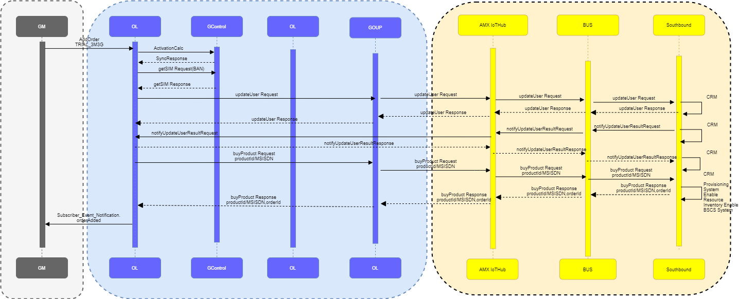
Scenario 1-a

Slide 6
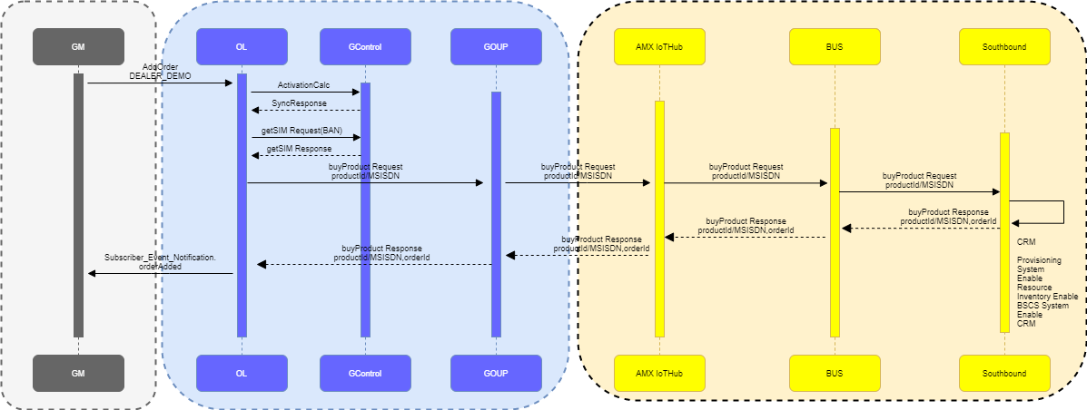
Scenario 1-b

Slide 7
Possible Solution - Scenario 1
Once AQ receives the “AddOrder”
AQ will validate for Country – if country is ‘Brazil’ then,
Check the product ID if it is from the table “OTC_reference”–
3) If Yes, then wait for the “buyproduct” Response, once success response received. Create the entry in “OTC_calc” Table.
4) If No, Then do not calculate any OTC.
5) If Failure Response received from Claro for Addorder, do not calculate any OTC.
Note –
Entries which are created in the “OTC_calc” table will be used at the time of monthly calculations.
“OTC_calc” table Structure is (MSISDN,Timestamp, productid, OTC charge).
Product ID | OTC Amount
GMTR1 | BRL 24.527
GMTRE | BRL 6.1318
GM20D | BRL 50.00

Slide 8
Scenario 2
OTC charges will be calculated in Monthly biginvoice report using “OTC_calc” Table.
MSISDN will have the mapping with the One Time charge with the date (Timestamp).
Script should check if date of One Time charge falls under the billing cycle.
If Yes then, reflect the One Time charge from ‘OTC_calc’ table in Monthly biginvoice report.
New row will be added for One Time Charge for plan in Biginvoice report.

Slide 9
Scenario 3
OTC charges will be calculated in Monthly “OTC report” using “OTC_calc” Table.
MSISDN will have the mapping with the One Time charge with the date (Timestamp).
ICCID and IMSI will be taken using MSISDN from Database.
Script should check if date of One Time charge falls under the billing cycle.
If Yes then, reflect the One Time charge from ‘OTC_calc’ table in Monthly “OTC report”.
OTC report will have - ‘ICCID’ ‘IMSI’ ‘MSISDN’ ‘OTC’ ‘Product id’ ‘Timestamp’ fields as column.
Sample –
File name – “Gcontrol_20210501_MonthlyOTCReport_100259213_1617867851812”
Frequency – Monthly
Type of file - .csv

